Slide 1


USA DROUGHT PROJECTION with Scikit-Learn
Mert Aydin, Shiyao Shang, Yihan Wang

Slide 2
Project intro

Slide 3
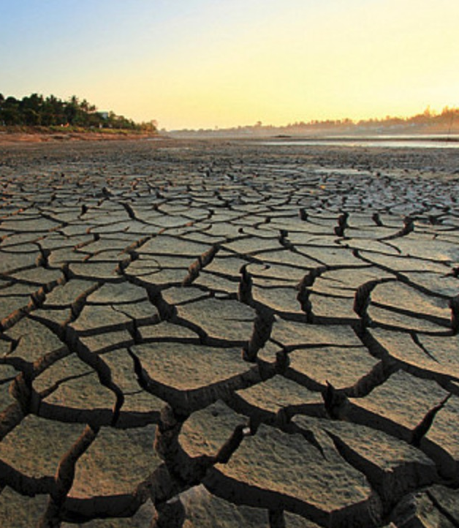
What is Drought?
Project intro
Drought is a prolonged dry period in the natural climate cycle that can occur anywhere in the world. It is a slow-onset disaster characterized by the lack of precipitation, resulting in a water shortage.
https://www.who.int/health-topics/drought#tab=tab_1

Slide 4
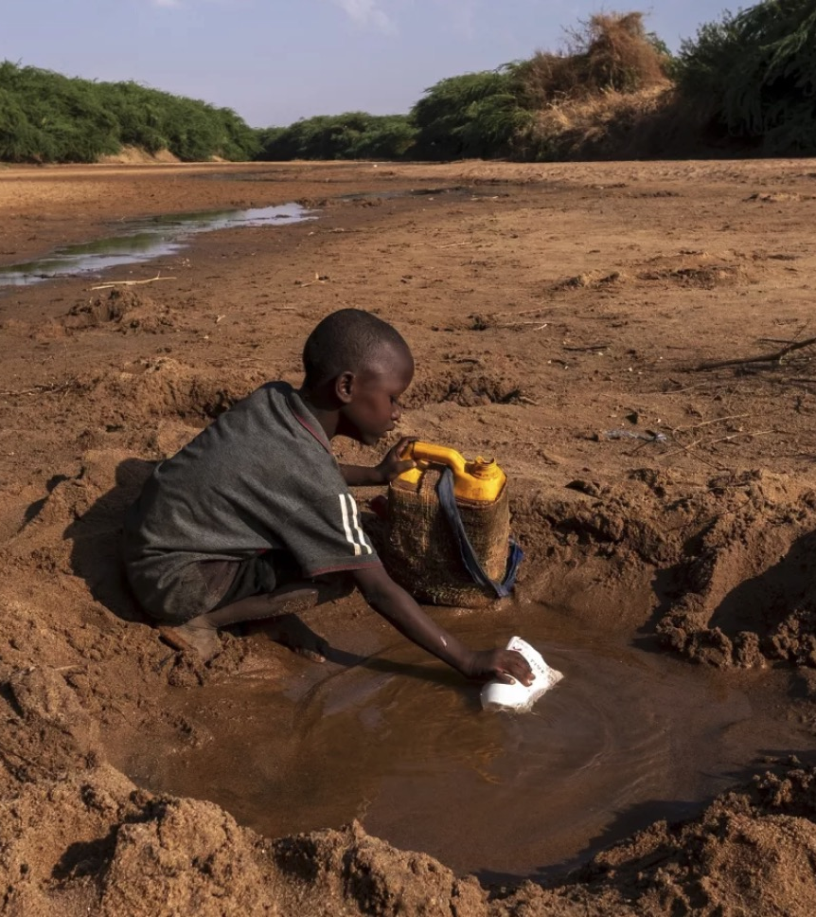
Drought Impacts and the Importance of Its Projection
Drought’s consequences are far-reaching, impacting water quality, public health, the economy, the natural environment, public infrastructure, and more
https://www.drought.gov

Slide 5
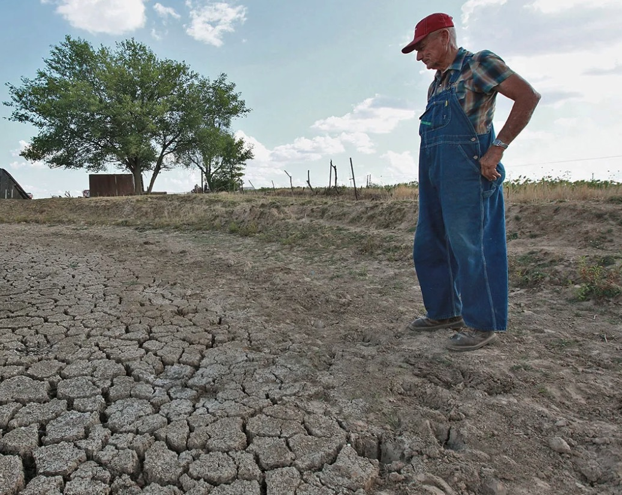
Drought Impacts and the Importance of Its Projection
Project intro
Water scarcity impacts 40% of the world’s population, and as many as 700 million people are at-risk of being displaced as a result of drought by 2030
https://www.who.int/health-topics/drought#tab=tab_1

Slide 6
What is PDSI?
Project intro
Developed by Wayne Palmer in 1965, the Palmer Drought Severity Index (PDSI) is a widely used tool for assessing drought conditions, focusing on long-term monitoring of moisture supply and demand.
PDSI values are standardized to range from -10 (extremely dry) to +10 (extremely wet).
https://en.wikipedia.org/wiki/Palmer_drought_index
https://www.droughtmanagement.info/palmer-drought-severity-index-pdsi/

Slide 7
Calculating the PDSI
Project intro
Collect Climate Data: Gather monthly precipitation, temperature, and soil moisture capacity data.
Calculate Potential Evapotranspiration (PET): Estimate PET, often using the Thornthwaite method.
Estimate Water Balance Components: Calculate potential recharge, runoff, loss, and moisture anomaly based on PET and precipitation.
Determine Monthly Moisture Anomaly (Z): Calculate deviations from typical moisture conditions.
Calculate the PDSI Value: Update the PDSI using Z values and regional climate variability.
https://www.ncei.noaa.gov/access/monitoring/weekly-palmers/overview
https://pubs.usgs.gov/publication/70013882

Slide 8


Project OUTLINE
Project intro
Research Question: Can drought be predicted with simple climate indicators like temperature and rain?
Decided to focus on the United States regions
Presence of different climate regions
Data availability
Extract US climate regions geojson data from data.gov
Put together 5 different datasets from Google Earth Engine
4 for actual climate data
1 for future climate data prediction
Use Machine Learning to predict PDSI

Slide 9
methodology
Data preparation
Data Preprocessing: extracted data by US climate regions and aggregated observations by month
Descriptive Analysis:
examined the data structure
visualized key columns using histograms
investigated correlation by visualization
checked skewness
Data Transformation:
created new features
removed non-feature columns
corrected data skewness of some features
removed outliers
Model Selection & Optimization: trained 5 machine learning models using Randomized Search Cross Validation; selected the SVM model with optimal performance

Slide 10
Data preparatıon

Slide 11
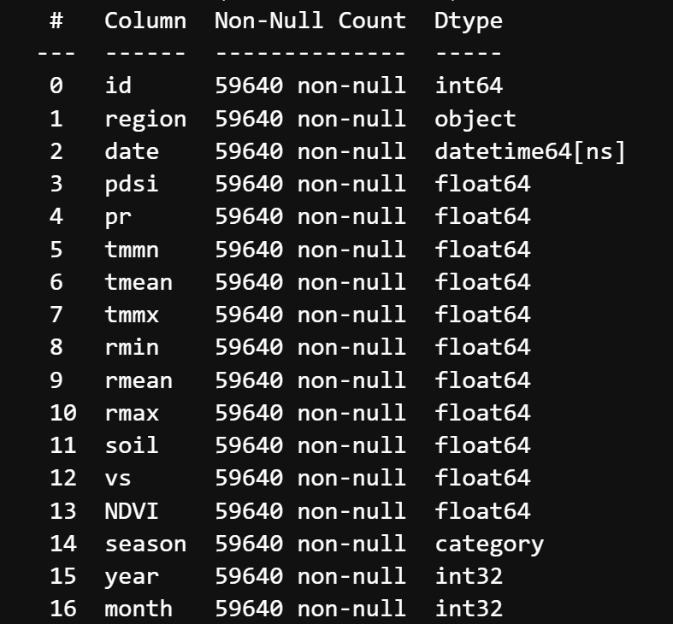
Almost 60-thousand rows of Data
Data preparation
Time Frame: 12 months * 14 years (2010 to 2023)
Regions Covered: 355 different regions within US
Data Structure: # of regions * time frame = 59640 rows, 17 columns
Main Feature Names:
PDSI (target)
Precipitation (pr)
Temperature (tmmn, tmean and tmmx)
Humidity (rmmn, rmean and rmmx)
Soil Moisture (soil)
Wind Speed (vs)
Normalized Difference Vegatation Index (NDVI)

Slide 12
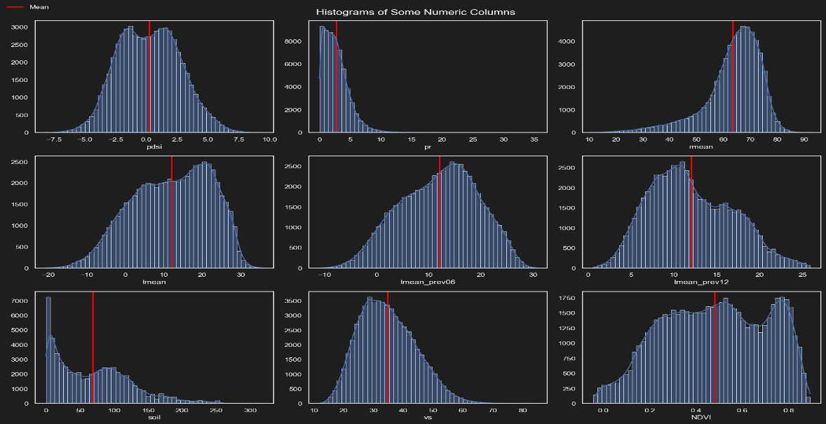
HISTOGRAMS INDICATING SKEWNESS
Data preparation
Right skew
Left skew

Slide 13
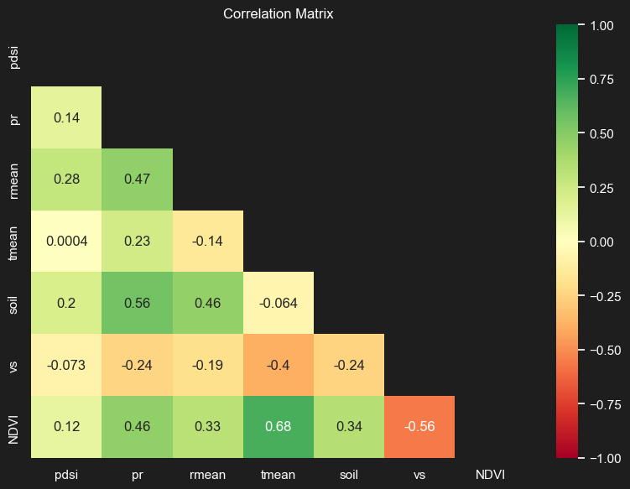
Some features have high correlation
Data preparation
Highly correlated feature
Highly correlated feature

Slide 14
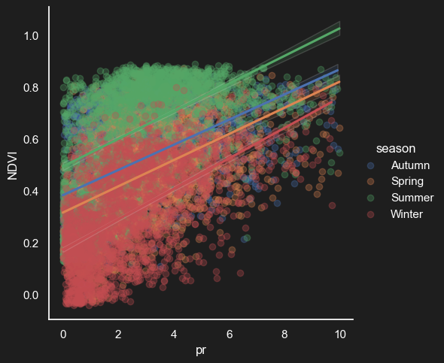
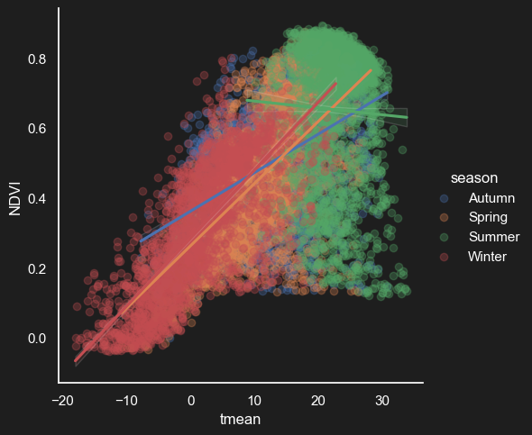
How temperature and rain affects NDVI
Data preparation

Slide 15
FEATURE Selection
Data preparation
Drop Non-Feature Columns
Since they are highly correlated with other main features
Drop columns such as NDVI and soil moisture as they are not available as forecast
Add New Features
Calculate rolling averages for specific climate variables over 3, 6, 12-month periods
Rationale: to capture short, medium, and long-term trends in climate data; help different models to learn from these patterns

Slide 16
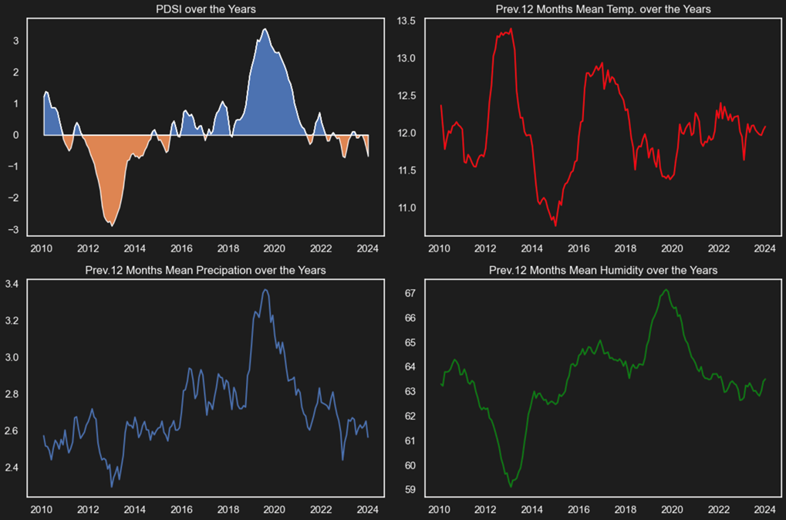
PDSI OVER THE YEARS
Data preparation

Slide 17
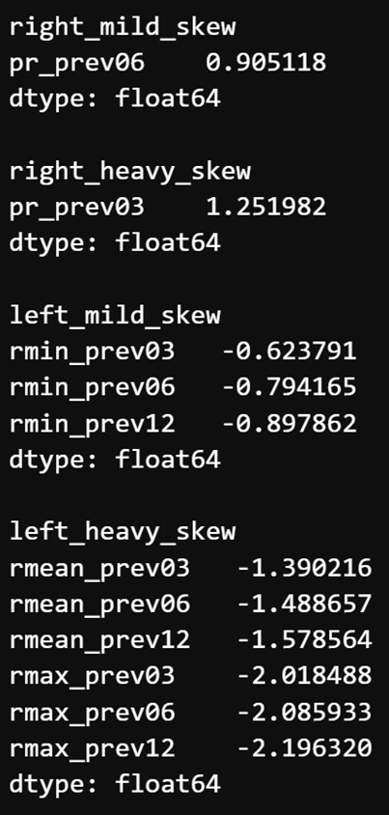
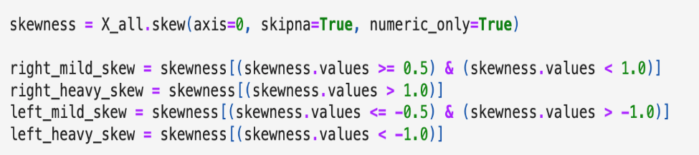
INVESTIGATE SKEWNESS FURTHER
Data preparation
Analyse skewness based on the histograms we draw earlier
Run skewness test to investigate it further

Slide 18
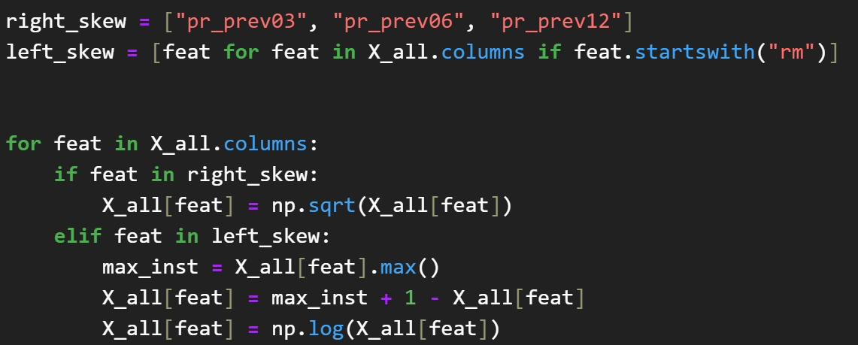
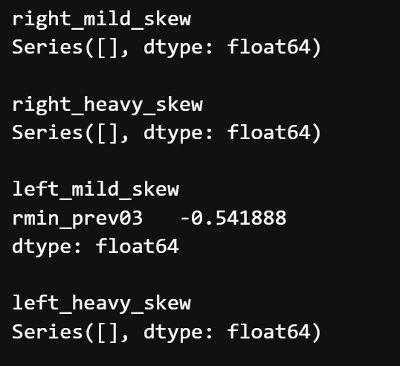
DATA TRANSFORMATION & repeat SKEWNESS TEST
Data preparation
Apply square root transformation
Reduced skewness to a mild level
Reverse the features then apply the log transformation

Slide 19
Model selection and results

Slide 20
Support vector machines outperforms other models
Model selection and results
Cross Validation Parameters:
Range of the target: 17.1
# of Cross-Fold: 3
# of Iterations: 10
Model | RMSE | Proc. Time(s) | Best Parameters
SVM | 1.82 | 1,434.79 | kernel: rbf gamma: scale | C: 10
Neural Network | 1.88 | 1,689.98 | activation: tanh alpha: 0.4576213 solver: sgd | hidden_layer_sizes: (100,) learning_rate: adaptive
k-Nearest Neighbours | 1.95 | 25.00 | weights: distance n_neighbors: 25
Gradient Boosting Regressor | 1.97 | 764.60 | max_depth: 38 max_features: 2 | n_estimators: 32
Random Forest | 1.99 | 1,088.73 | max_depth: 25 max_features: 4 | n_estimators: 56
Linear Regression | 2.27 | 1.58

Slide 21
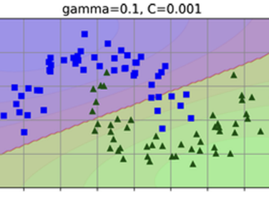
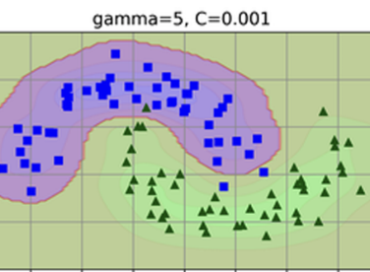
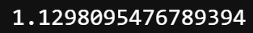
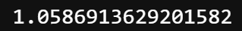
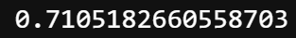
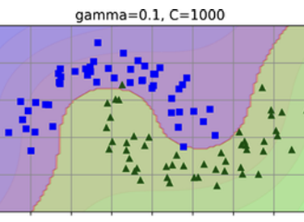
SVM performance improves WITH test and training set
Model selection and results
Result with the whole training data:
Result with increased C(=20) parameter:
Result with increased C parameter on the test data:
Remember that the range of the target value is 17.1
Source of Pictures: Géron, Aurélien. Hands-on machine learning with Scikit-Learn, Keras, and TensorFlow: Concepts, tools, and techniques to build intelligent systems. O'Reilly Media, 2019.

Slide 22
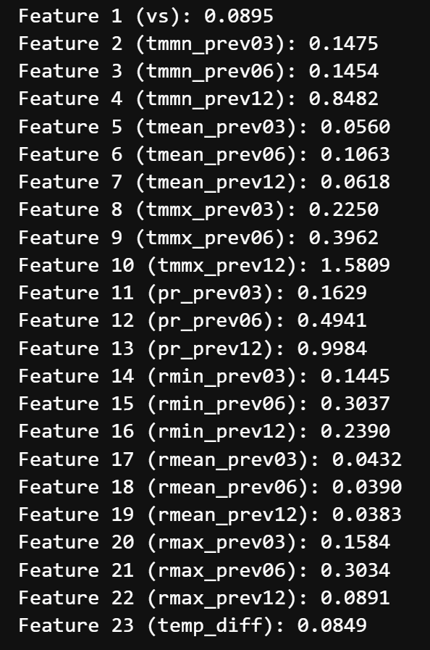

Feature importance request more emphasis on the past
Model selection and results
Some features such as tmean, rmean and temp_diff given very low importance
Removed those features and re-trained out model
Test results w/o those features is very slightly worse (baseline was ≈ 1.0587)
Highest importance given to previous 12 months average precipitation and temperature data
Instead of using previous 3-, 6- and 12-months averages, we’ll use 6-, 12-, 18- and 24-months averages
This will cost us loos of 2011 as a training data
Data Transformation and Outlier Removal had to be re-performed

Slide 23
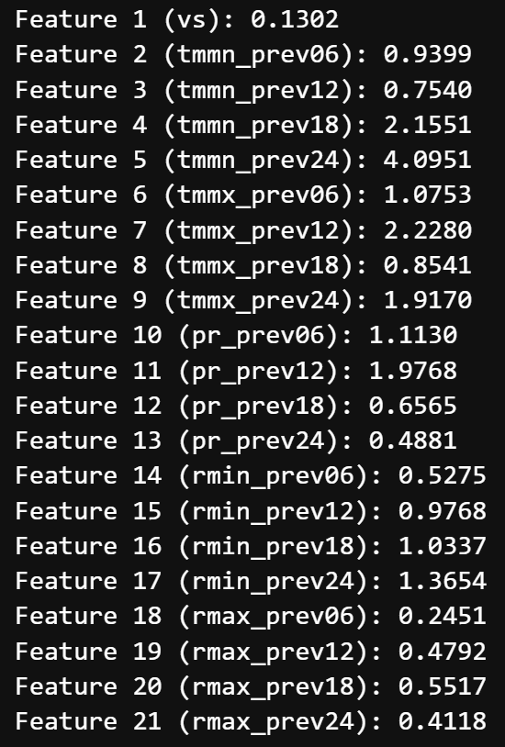
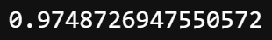
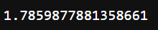
Feature Optimization leads more balanced importances
Model selection and results
Feature optimization:
Drop low importance features to reduce noise
Add new, possibly important features
As a result, we’ve managed to reduce RMSE below 1 (baseline was ≈ 1.0587)
Unfortunately, PCA did not lead to further improvement:
Test results with PCA n_components = 0.85:
Test results with PCA n_components = 0.95:

Slide 24
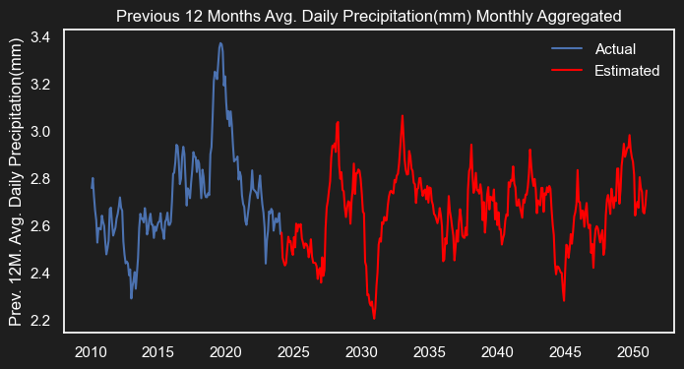
NASA precipitation predictions fluctuates
Model selection and results

Slide 25
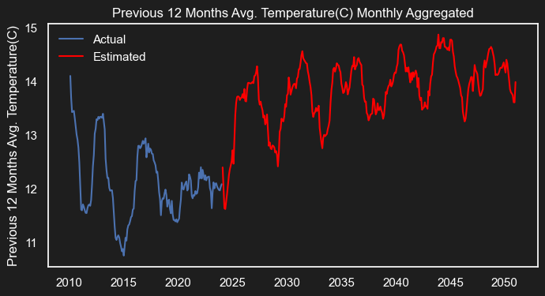
NASA predicts increase in temp.
Model selection and results

Slide 26
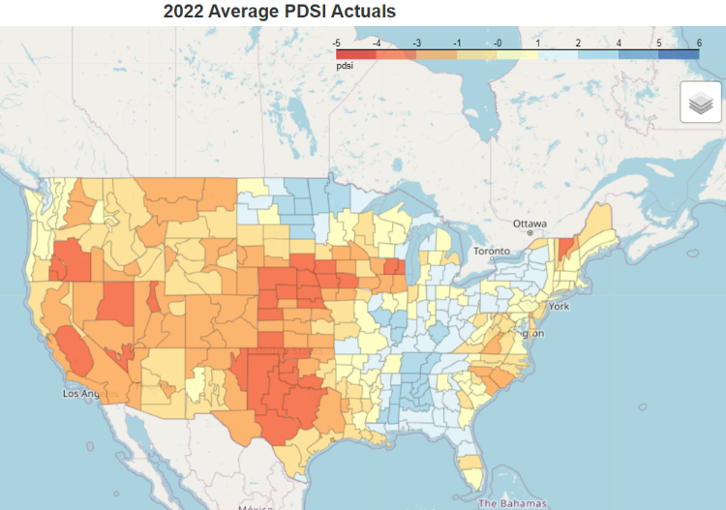
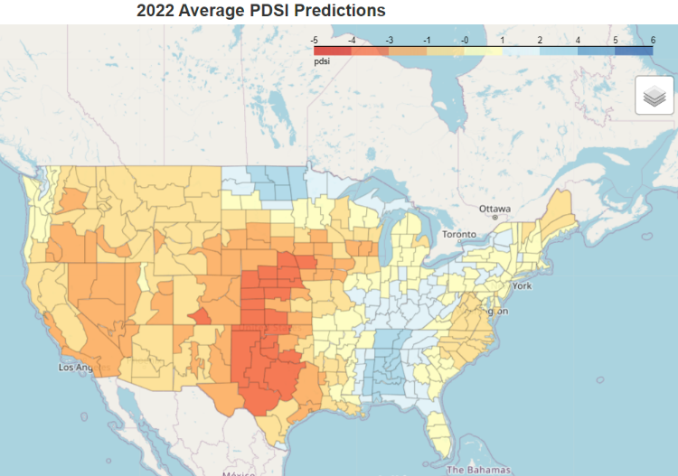
2022 pdsı actual vs predictions
Model selection and results

Slide 27
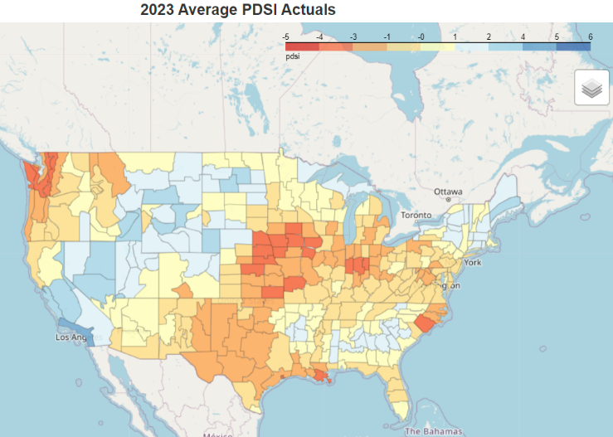
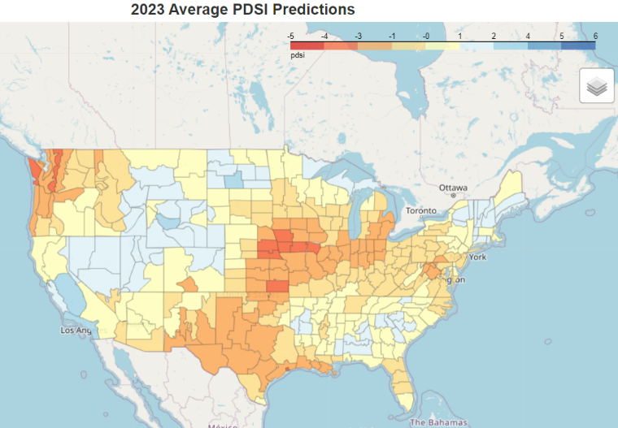
2023 pdsı actual vs predictions
Model selection and results

Slide 28
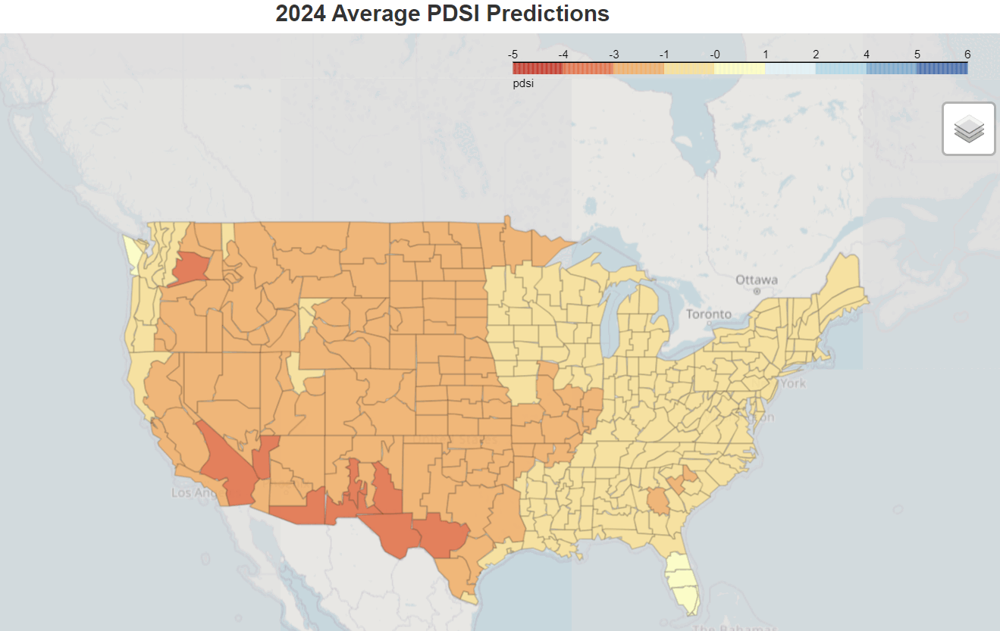
PDSI projection 2024-2050
Model selection and results

Slide 29
THANKS FOR YOUR ATTENTION

